Slide 1


SIMATS ENGINEERING
SAVEETHA INSTITUTE OF MEDICAL AND
TECHNICAL SCIENCES
CipherSense : AI-Powered Cryptanalysis and Security Assessment Toolkit
CSA5116– CRYPTOGRAPHY AND NETWORK SECURITY
Presented by:
Vempati Murale Karrtik (192312567)
G Vignesh (192373051)
Katappagari Vineela (192312423)
Kotapati Harshitha (192324202)
Guided By:
DR. D. Sudhagar

Slide 2
ABSTRACT
AI-Powered Cryptanalysis and Security Assessment Toolkit is a project designed to analyze encrypted messages and evaluate the security of classical encryption techniques using artificial intelligence and machine learning. The system focuses on ciphers such as Caesar, substitution, and transposition to identify possible weaknesses through frequency analysis, pattern recognition, and automated cryptanalysis. It provides a user-friendly interface for encryption, decryption, ciphertext analysis, and security assessment. The main aim of CipherSense is to help users understand how encryption techniques work, identify their vulnerabilities, and learn the importance of secure encryption methods in modern cybersecurity.

Slide 3
INTRODUCTION
Protects sensitive information from unauthorized access using advanced cryptographic techniques.
Uses Artificial Intelligence to automate cryptographic analysis and improve security assessment.
Reduces the time and effort required for manual cryptanalysis with intelligent automation.
Supports secure encryption and decryption methods to ensure safe data communication.
Enhances cybersecurity awareness by providing intelligent insights for better decision-making.

Slide 4
PROBLEM STATEMENT
Existing cryptanalysis tools provide limited security analysis capabilities.
Selecting the right encryption algorithm is difficult for many users.
Weak encryption methods increase the risk of cyberattacks and data breaches.
Manual vulnerability assessment is time-consuming and requires expert knowledge.
AI-based intelligent security assessment platforms are needed for faster and more accurate recommendations.

Slide 5
LITERATURE REVIEW
S.No | Details of the Journal | Algorithm / Methodology Used | Advantages | Disadvantages
1 | AI-Based Cryptanalysis for Classical Ciphers (2025) | Machine Learning, Frequency Analysis | Faster cipher detection and improved accuracy | Limited to classical ciphers
2 | Intelligent Cryptography Security Assessment (2024) | Random Forest, Feature Extraction | Identifies security weaknesses automatically | Requires quality training data
3 | Deep Learning for Cryptanalysis (2024) | Convolutional Neural Network (CNN) | High accuracy in pattern recognition | High computational cost
4 | Explainable AI in Cybersecurity (2023) | Explainable AI (XAI) | Easy to understand AI decisions | Lower performance for complex attacks
5 | AI-Driven Security Assessment Toolkit (2025) | Machine Learning + Rule-Based Analysis | Real-time analysis and recommendations | Less effective for unknown attack patterns

Slide 6
EXISTING SYSTEM
The existing system mainly relies on traditional cryptographic tools that perform basic encryption and decryption using predefined algorithms.
Security analysis is often carried out manually using techniques such as frequency analysis and pattern recognition.
These tools generally provide limited automation and do not integrate user data management and AI-based recommendations, comprehensive cryptanalysis, and security assessment into a single platform
As a result, users may find it difficult to identify cipher vulnerabilities and understand the security level of different encryption techniques.

Slide 7
PROPOSED SYSTEM
The User Input & Data Management module collects and manages user inputs and messages.
The AI Recommendation Engine suggests suitable cryptographic techniques based on the selected requirements.
The Cryptanalysis & Security Assessment module analyzes encrypted messages, identifies potential vulnerabilities, and evaluates cipher security.
Finally, the Encryption, Decryption, Reports & Dashboard module performs encryption and decryption, generates analysis reports, and displays results through an interactive dashboard.
The system aims to make cryptographic analysis more automated, user-friendly, and effective for educational and security assessment purposes.

Slide 8
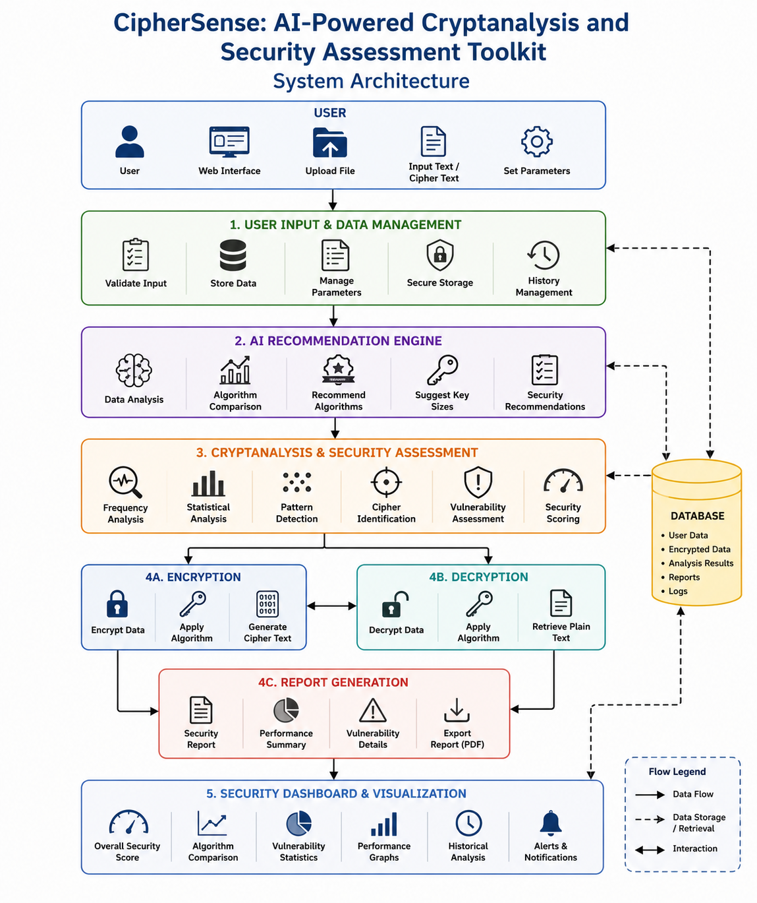
SYSTEM ARCHITECTURE

Slide 9
PROJECT MODULES
Module 1: User Input & Data Management
Module 2: AI Recommendation Engine
Module 3: Cryptanalysis & Security Assessment
Module 4: Encryption, Decryption, Reports & Dashboard

